Slide 1
Title
Alexander Mohr
Sr Product Manager, Technology Alliances
Date
Marina Kozhevnikova
D1 CoE Lead Consultant

Slide 2
Why OnDemand?
~2,000
THE PROBLEM
ONDEMAND DELIVERS
Stuck small customers churn
Expert help, on demand
Dynatrace customers under $100K ARR who can't justify traditional services
Limited post-sales support; can't justify services
Fast pass to experts when customers are stuck
Hit friction when the path forward isn't clear
Quick removal of adoption and configuration blockers
Hands-on work, coaching, and best-practice guidance
Stall, under-adopt, and ultimately churn
Flexible credits — targeted, scalable help
Notes:
Why OnDemand?
This really comes down to a gap we’ve had in our model
We have ~2,000 smaller customers with Dynatrace who can’t justify traditional services, and they don’t get enough post-sales support to move forward confidently
A common scenario for these customers is they hit some piece of friction within Dynatrace when trying to get started – whether that is stuck with some piece of their implementation, they need some best practice guidance on how to approach a specific problem or objective, they just can’t figure out how to write a DQL query to get the results they need for something, and they really just need to get a smart person on the phone for 60 minutes to help them out
We historically haven’t had a great path for small customers in these scenarios. They sometimes show up in support/chat, or the AE/SE/CSM calls in favors, but there really is not an easy button for this
OnDemand is how we solve that – giving customers a fast pass to experts right when they’re stuck so they can keep up momentum in adopting Dynatrace
It’s hands-on help, it’s guidance – living in a lightweight, flexible way through a simple credits model

Slide 3





OnDemand Core Components
Credits
Task
Catalog
Customer Portal
Right Expert, Right Time
“Currency” customers use to exchange for task work
No monetary value
The deliverable: pre-defined, short-term, and outcome-oriented tasks
Technical guidance and hands-on
Tasks organized into catalogs (a delivery menu) by product or use case
Customers request task work through a case portal
Pooled delivery model to deliver right expert, right time
Example tasks:
Build a dashboard
Write or optimize DQL queries
Dynatrace 101 session
Review setup & best practices
Notes:
At a high level OnDemand is a pretty simple model
Customers get credits, which they spend on specific tasks.
Credits have no monetary value – you get a set amount to use each month as part of your Dynatrace subscription with no option to roll credits over or purchase additional credits
Tasks are predefined — scoped, outcome-focused pieces of work – think build a dashboard, writing DQL, or reviewing their setup
Those tasks live in a catalog, so expectations are clear upfront
This helps both from the customers perspective of ‘what’s in scope of OnDemand/what will be delivered through this task’ and from the backend for us to standardize how we deliver each task and work towards consistency and efficiency of delivery with runbooks, automation, etc. which is important for scale and ensuring a consistent, high-quality experience for customers no matter who delivers the task
This also gives us the ability to align very closely with Wayfinder in a structured way in terms of what we support and how we deliver
Requests come in through the customer support portal in the form of OnDemand cases, and we deliver through a pooled model – matching the customer with the right expert quickly
Now again, these are requests that take maybe an hour to complete, they are short, fast, and targeted – not longer or scoped engagements that are better for professional services (however, an OnDemand task could be a great feeder engagement to a larger project need)

Slide 4
What OnDemand Covers
Getting Started
Get Your Data In
Manage Your Environment
Visualize & Report
EXAMPLES
EXAMPLES
EXAMPLES
EXAMPLES
Welcome to Dynatrace Support & OnDemand
Dynatrace 101
OneAgent Deployment
Bring your Logs
Environment Foundations
User Roles & Access Control
Dashboarding & DQL Assistance
Detect Problems
Understand Users
Automate with
Dynatrace
Optimize
EXAMPLES
EXAMPLES
EXAMPLES
EXAMPLES
Anomaly Detection 101
Alerts & Notifications
Real User Monitoring
Synthetic Monitoring
Workflows
Dynatrace API
Environment Review
Observability Guidance
Plus more across every category — full catalog available on request
Notes:
Don’t worry about going through all of this – this is just a click down into the OnDemand Catalog itself.
The key takeaway is coverage OnDemand will give customers — we’ll have a catalog with tasks that span most of what customers get stuck on across the platform.
If a customer says ‘I don’t know how to do something’ or ‘we’re blocked’ or ‘I’d like to run this approach by an expert in this area’ and it’s something we can jump in quickly and help them out with in a call or two, this is where OnDemand fits.
It’s broad, practical help — not one specific use case.

Slide 5
Pilot Launch Overview
1,800
5
Monthly credits
Redeemable for hands-on work, coaching, or live sessions from the OnDemand catalog
Included as part of their Dynatrace subscription (ESS and Non-ESS)
July 13, 2026
Pilot customers
NORAM + EMEA customers under $250K ARR
Dynatrace Core customers
Aligned with Welcome Wagon
Target launch
Dedicated CSE team led by Jacob Lawler; expanding broader if successful
Larger or longer-running projects may be better suited for a separate professional services engagement
Notes:
We’re launching this as a pilot first
~1,800 customers across NORAM and EMEA under $250K ARR will get this automatically
This encompasses new and existing customers July onwards, ESS or Non-ESS
We are participating in the Dynatrace Core pilot for NORAM and EMEA, and expanding as this pilot expands
We’re aligned with Welcome Wagon – this is how new customers July onwards will find out about OnDemand in both NORAM and EMEA
Each customer gets 5 credits per month included in their Dynatrace subscription (nothing to sell or add to the quote)
Launch is targeted for July 13
This is handled by a dedicated CSE team today, with the goal to expand if it works.
And anything larger or more complex still routes to services

Slide 6
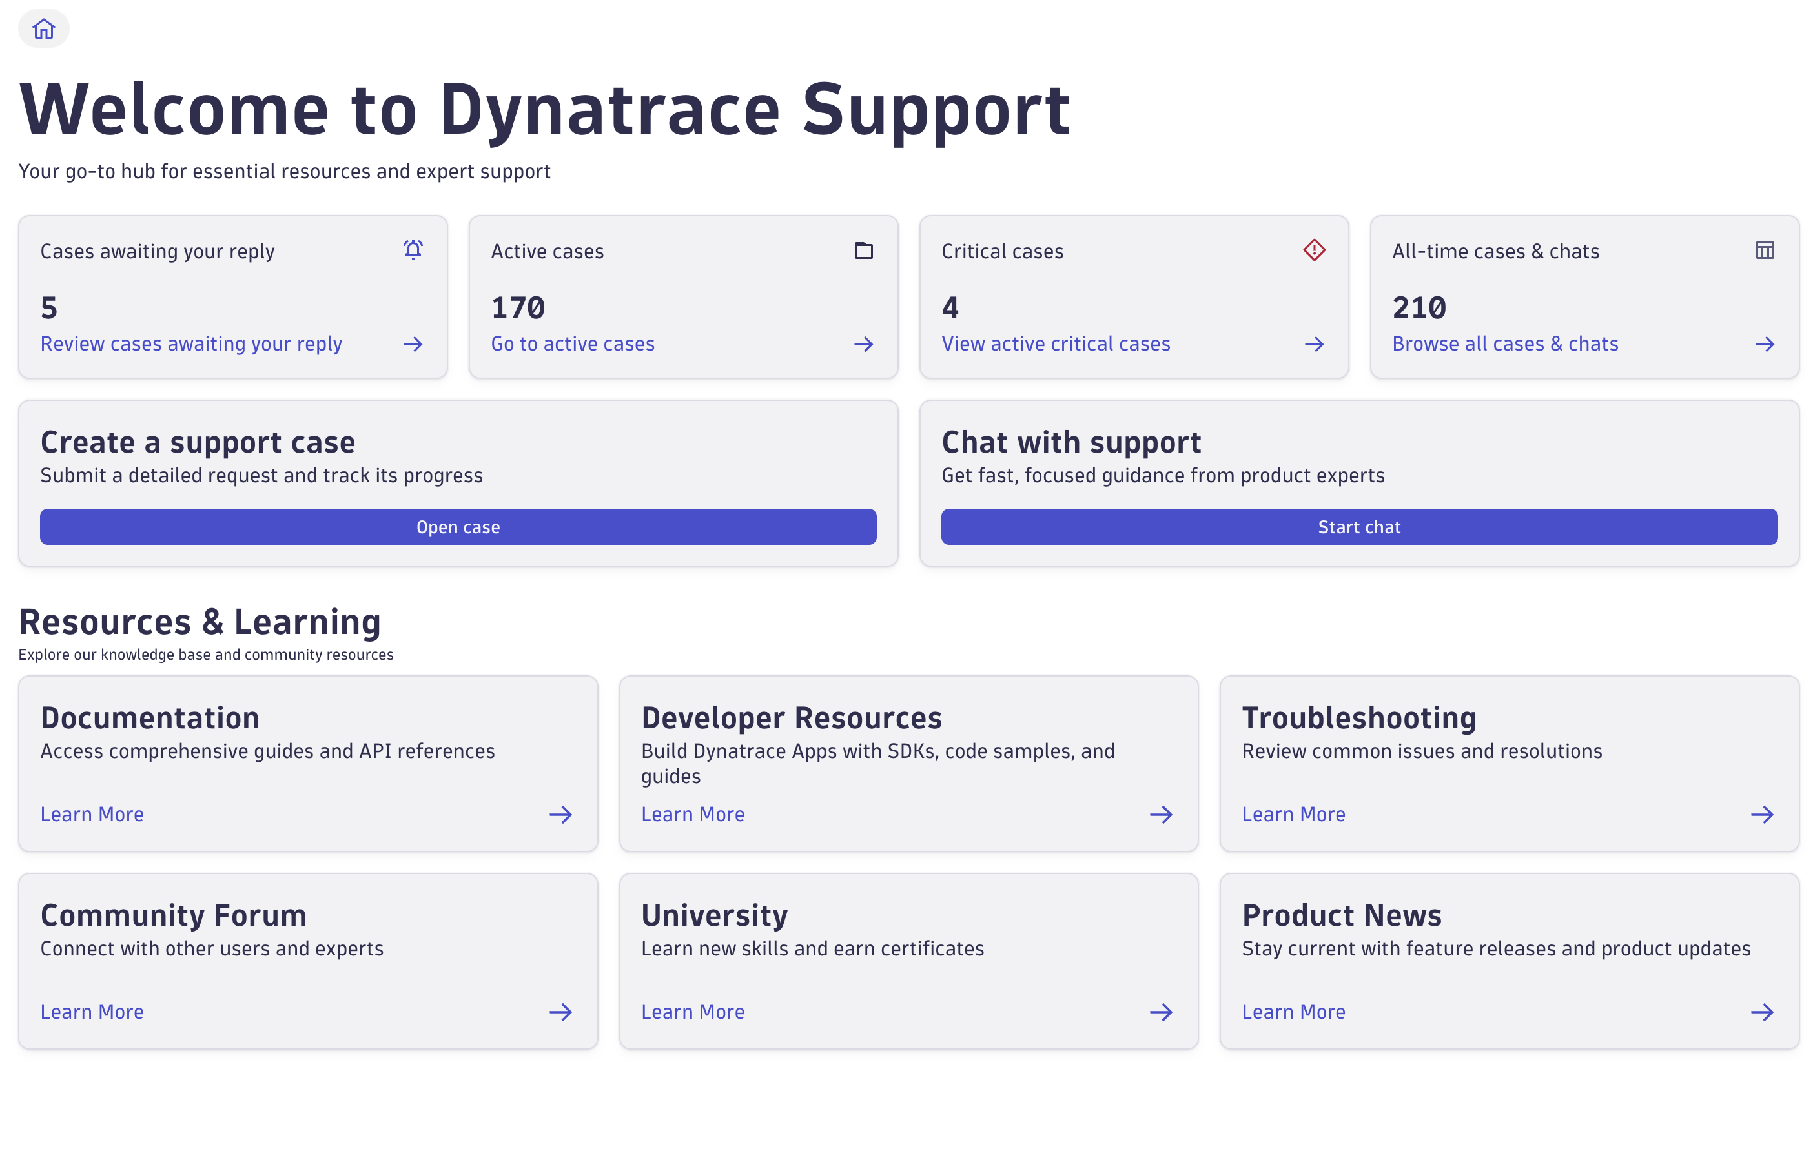
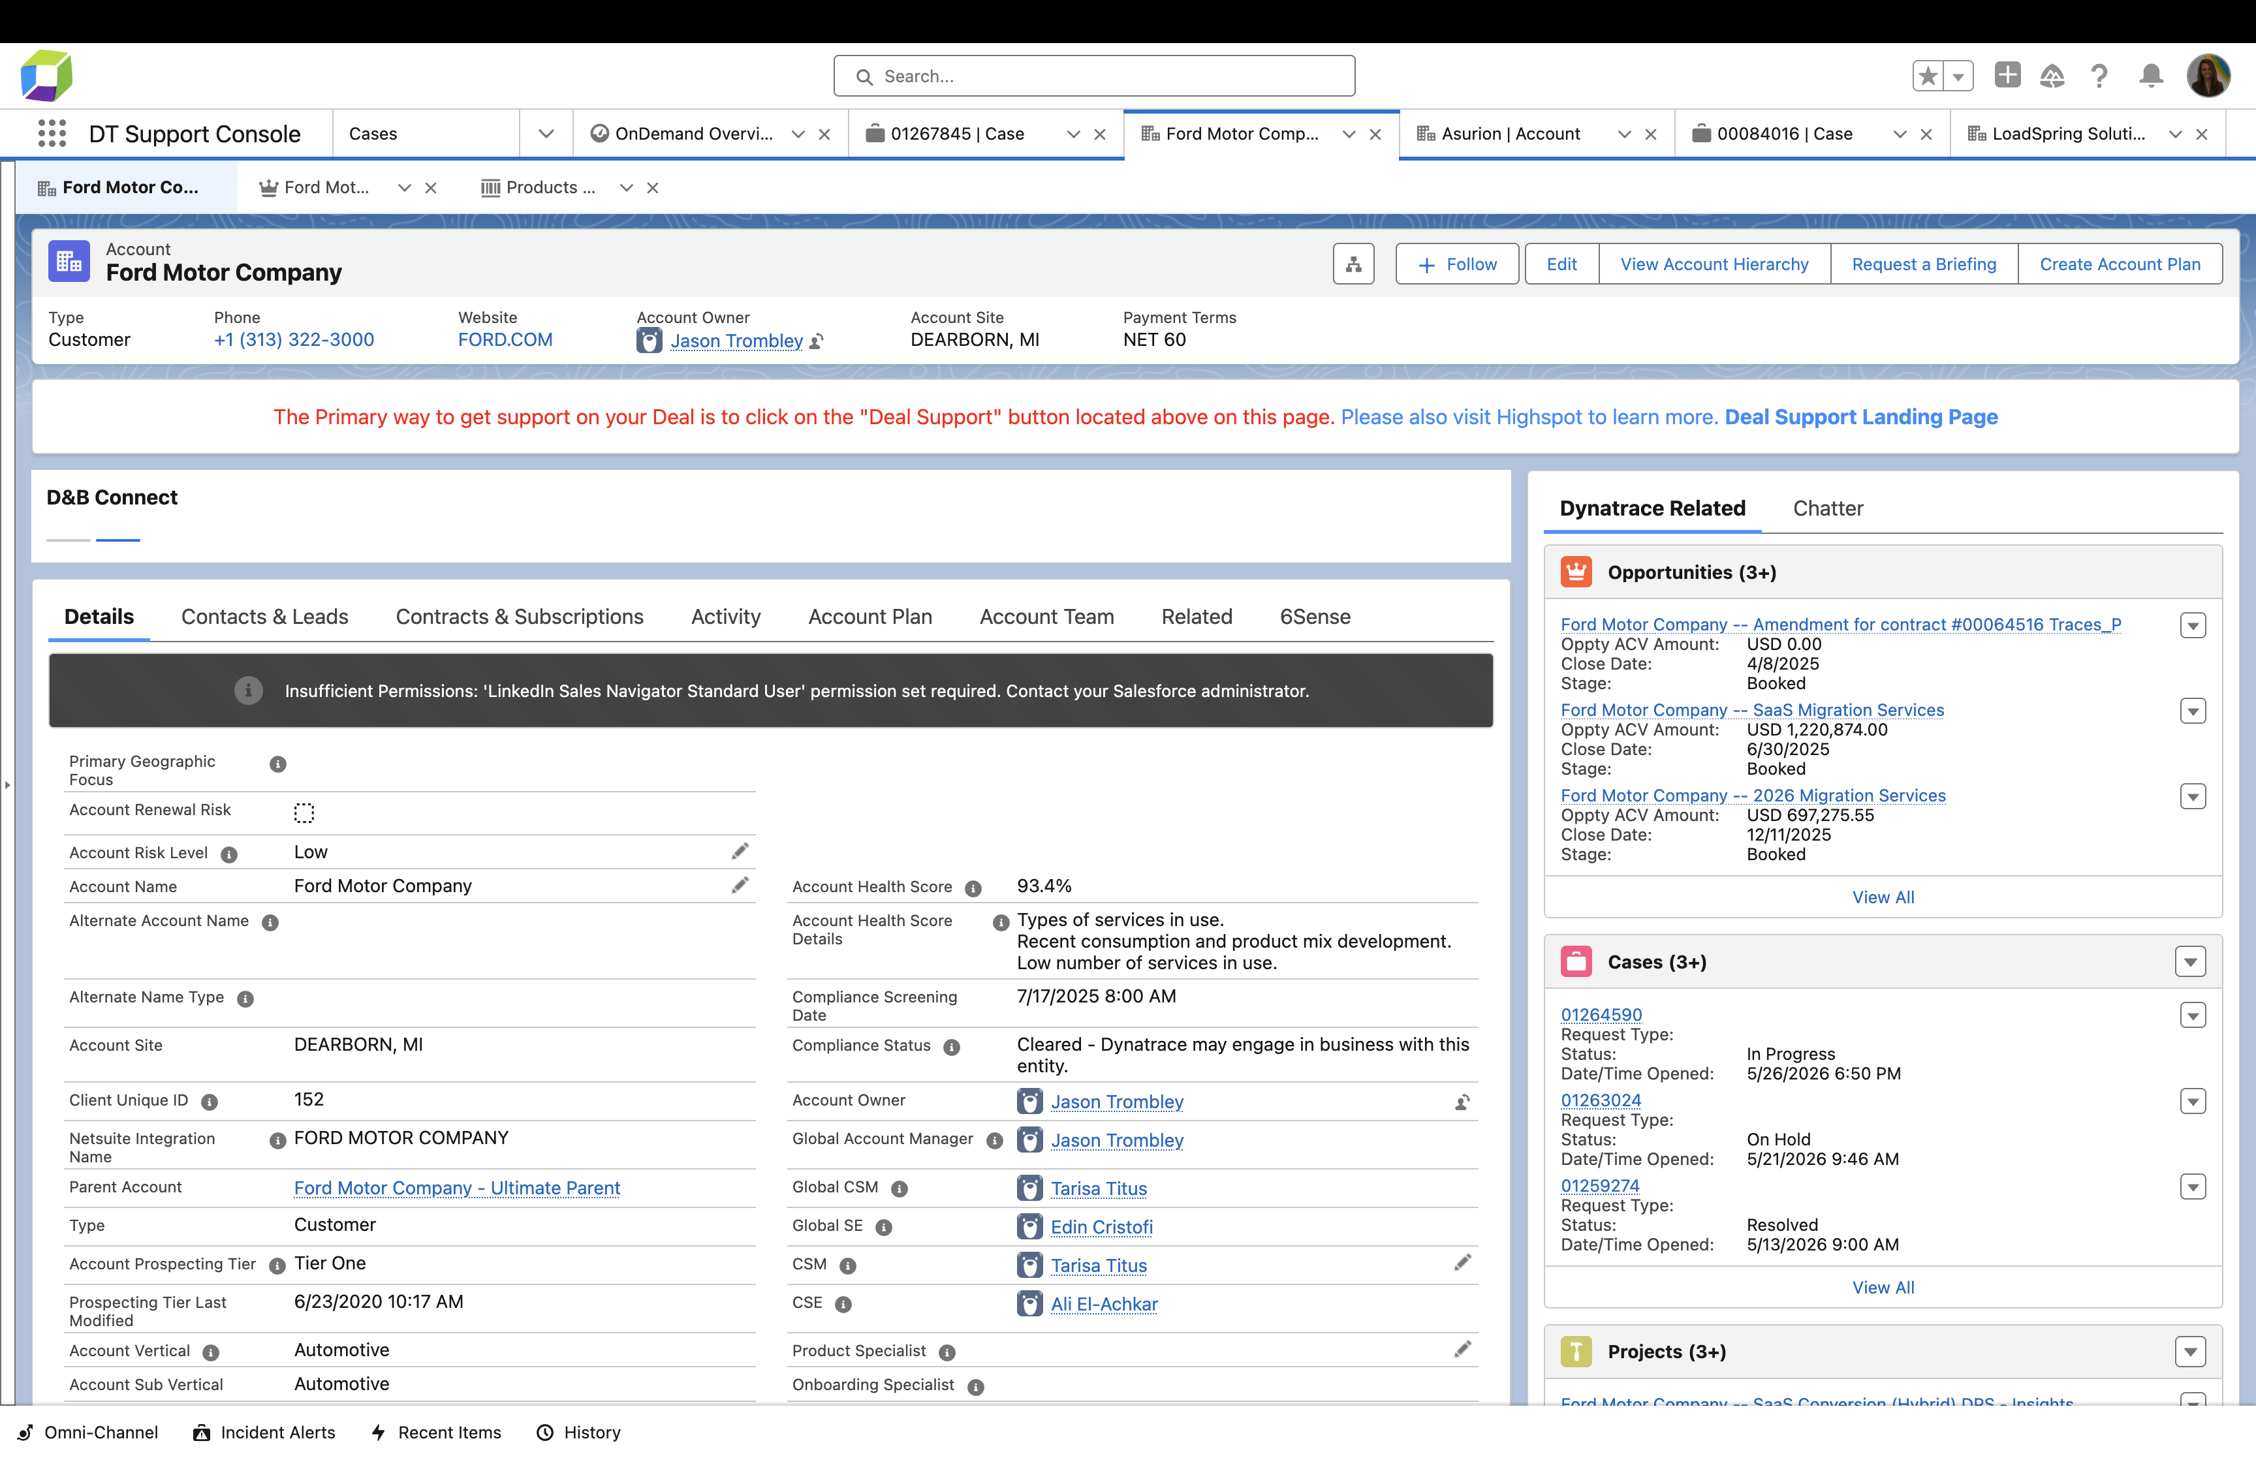
Getting Started with the OnDemand Pilot
How to tell if your customer is in the pilot – and how they get help
Identifying an OnDemand Customer
OnDemand Customers can be identified by referencing the new “Strategic Initiative” object on the customer's account page in Salesforce (coming July 2026)
Submitting Requests
The customer can submit requests through the customer experience portal → and future D1 App!
Notes:
These are the two questions we get asked most frequently – how to tell if a customer is in the pilot and how they’ll get help
You’ll be able to see in Salesforce which accounts are part of the pilot and how many credits they are allocated
From there, customers submit requests directly through the portal – there will be a dropdown type for OnDemand
An important thing to note for this first pilot is you’ll be able to see if a customer is part of the pilot and how many credits they are allocated, but we aren’t doing any sophisticated credit tracking or depletion right away – it’ll be mostly manual tracking done by the pilot team – more automatic and visible-to-you credit usage will come at a later date.

Slide 7
How is OnDemand Different?
Professional Services
Project-based engagements — e.g., DT Resident Admin, large migrations, multi-month projects where continuity is critical.
THE CAPABILITY
OnDemand
Right expert, right time.
Chat
First line of support for product issues and quick how-to questions.
Short, scoped technical engagements — outcome-oriented
Technical guidance, advisory, and planning
Lightweight hands-on work
Product Support
Break / fix — owns product issues, defects, and incidents.
CSM / CSE
Long-term, embedded, named relationship owners — vs. OnDemand's short-term, pooled, non-named model.
Notes:
This slide is really about where OnDemand fits — and just as importantly, where it doesn’t.
At its core, OnDemand is about short, scoped engagements — quick, outcome-focused help when a customer is trying to move something forward.
It’s technical guidance, best practice advice, and lightweight hands-on work — things we can help with in a session or two, not a long engagement.
Contrast to others:
If the work turns into something larger — multi-step, ongoing, weeks/months, requires a SOW, there are deadlines, or requiring continuity — that’s where Professional Services comes in.
If it’s a quick question or how-to, Chat is still the fastest path.
If something is broken or not working, that stays with Product Support.
And CSMs and CSEs are still the embedded, long-term relationship owners — OnDemand just gives them a way to get customers unblocked quickly without needing a named resource.

Slide 8
How This Impacts You
Customer Success
Support/Chat
Services
Key Takeaway: Minimal impact – pilot targets smaller accounts with little CSM support
If you do have a pilot customer:
Encourage them to leverage OnDemand for task-based requests as needs arise
You can submit OnDemand requests on behalf of customers when needed
Key Takeaway: Business as usual – continue supporting the customer in-channel
Be aware OnDemand is an option for customers and familiar with the program
Where it makes sense, mention OnDemand to eligible customers as a program they can try in the future to get help with tasks
Key Takeaway: Minimal impact – pilot focuses on smaller customers with little to no services
If you do have a pilot customer:
Continue supporting customers as you normally would
As it makes sense, you can suggest OnDemand for smaller, standalone tasks where it adds additional value/lift
Notes:
Overall, this is low impact – for this pilot we’re filling a gap for smaller customers, not changing how teams operate
For all roles the primary ask for you is just to maintain awareness OnDemand is an option for small customers and be familiar with the program so you can talk to it from a high-level if you do come across it in an account or with sales
More specifically
If you are in customer success and do have a pilot customer (and likely no CSE) you can encourage them to leverage OnDemand for task-based requests, or submit yourself on their behalf
Support/chat be familiar again this is an option for smaller customers and where it makes sense and if the customer is eligible you can mention it at the end of a support/chat as something they can try next time but no pressure at this time to focus on rerouting requests – we’ll primarily continue supporting the customer in-channel and as OnDemand expands and we learn we’ll update guidance here as it makes sense
For services, again, most customers won’t have both OnDemand + services but where it does show up continue supporting the customer as you normally would and as it makes sense and the customer is eligible, you can suggest OnDemand for standalone tasks where it adds additional value or lift

Slide 9
What Happens Next
1
More resources on the way
Lookout for a site with additional resources (FAQ, fact sheet, catalog) and an OnDemand help slack channel for questions and feedback
QUESTIONS OR FEEDBACK?
Get in touch with the OnDemand team
2
Customer OnDemand awareness communications sent
Campaign sent on July 13 aligned with launch date and ongoing via Welcome Wagon
Brittany Connett
Senior Director, OnDemand
Brittany.connett@Dynatrace.com
3
All NORAM and EMEA accounts under $250K get OnDemand by default after July
Jacob Lawler
OnDemand Manager — day-to-day
Jacob.lawler@Dynatrace.com
Expansion to larger customers after a 3-4 month learning period
Notes:
Ok to wrap it up!
Next steps — we’ll have assets in Highspot and SharePoint ready prior to July 13, including FAQs and customer-facing slides and materials
We’ll also have a slack channel for feedback and questions
Customers that are part of the pilot will receive communications aligned with the July launch through a campaign and then ongoing via Welcome Wagon
And over time, this becomes the default for sub-$250K customers, with plans to expand
Reach out with any questions to me directly, I’m happy to chat further - also look out for that slack channel I mentioned for questions/feedback as well
With that, we'll take any questions

